Slide 1


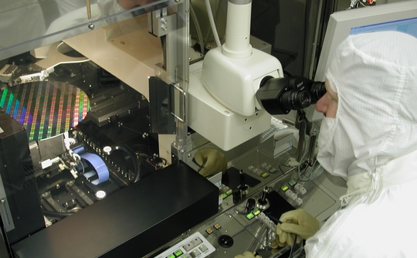
“The Lost Language of Privacy”- Brooks
The Beauty and Joy of Computing Lecture #16
Data and Information
David Brooks waxes poetic about privacy in a NY Times piece about the pros/cons of police body cameras. He talks about why privacy is important to the development of full individuals, of families and friendships, and for communities. Read it!
www.nytimes.com/2015/04/14/opinion/david-brooks-the-lost-language-of-privacy.html

Slide 2
Admin Notes
Midterm tomorrow. Good Luck!
No Lecture
“In-Lab” Portion:
90 minutes
Take the survey
Don’t Stress!
Clobber Policy
Next Week: “Explore” Post, a bit lighter.

Slide 3
Data and Information

Slide 4
3 Components
Analyze
Manipulate
Communicate
Data

Slide 5
Data & Information Facilitate Knowledge
Computers are used in an iterative and interactive way when processing digital information to gain insight and knowledge.
Digital information can be filtered and cleaned by using computers to process information.
Combining data sources, clustering data, and data classification are part of the process of using computers to process information.
Insight and knowledge can be obtained from translating and transforming digitally represented information.
Patterns can emerge when data is transformed using computational tools.

Slide 6
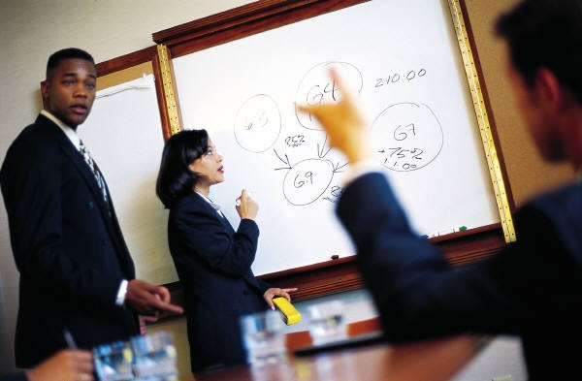
A Human Component
Collaboration, in working with data to gain insight and knowledge:
…is an important part!
…applies multiple perspectives, experiences, and skill sets.
…involves communication between participants.
…includes developing hypotheses and questions, and in testing hypotheses and answering questions.
…can benefit from face-to-face and using online collaborative tools
…when Investigating large data sets can lead to insight and knowledge not obtained when working alone.

Slide 7
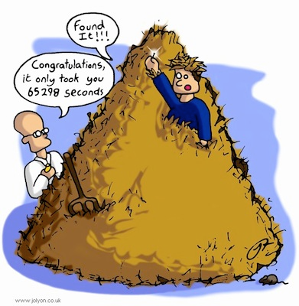
A Computational Component
Large data sets
provide opportunities and challenges for extracting information and knowledge.
provide opportunities for identifying trends, making connections in data, and solving problems.
Need computing tools to facilitate the discovery of connections
For efficiently finding, recognizing patterns and finding trends in information…
Search tools are essential.
Information filtering systems are important tools
Software tools, including spreadsheets and databases can help

Slide 8
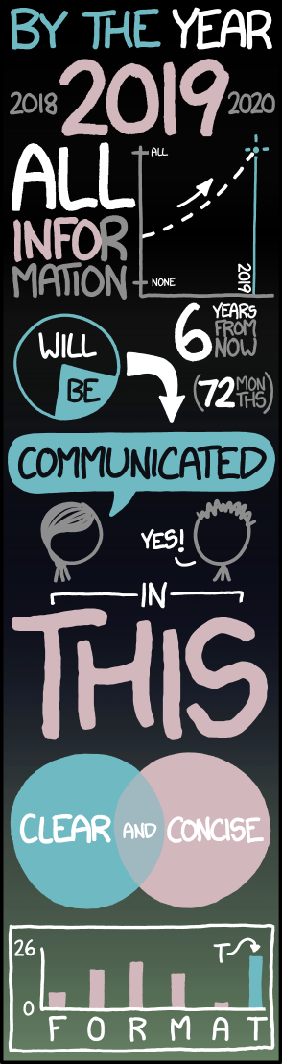
Big Data Concerns
Large data sets include data such as transactions, measurements, texts, sounds, images, and videos.
The storing, processing, and curating of large data sets is challenging or sometimes impossible.
Structuring large data sets for analysis can be challenging.
Maintaining privacy of large data sets containing personal information can be challenging.
Scalability of systems is an important consideration when data sets are large.
Analytical techniques to store, manage, transmit, and process data sets change as the size of data sets scale.
Technical problems affect how data set is used.
xkcd.com/1273

Slide 9
Data is Ubiquitous
…we work with it all the time:
Data is collected any moment of your life
Data is stored, copied, transmitted, deleted, edited.
Computers perform operations on data
Data enters and exits through sensors
We can measure it!
1 bit = ‘0’ or ’1’
1 Byte = 8 bits
1 KiB = 1024 Bytes, 1MiB = 1024 KiB, 1GiB = 1024 MiB, 1TiB=1024 GiB, 1PiB = 1024 TiB, …

Slide 10
How much is…?
1 KiB?
Long Paragraph of text (500-1,000 characters)
1 MiB?
4 megapixel JPEG (compressed) image
.33 MP image UNcompressed
1 GiB?
One hour of standard def TV or 7 minutes of HDTV
1 TiB?
2,000 hours of audio (uncompressed), 17,000 hours of MP3s
1 PiB?
Store the DNA of the entire population of the US – 3x!

Slide 11
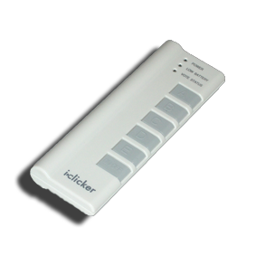
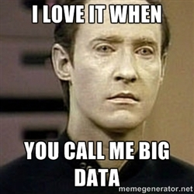
Clicker Question
What do you think is the biggest data overall?
Text
Images
DNA
Videos
Census Data
Notes:
Data and information is hard to define. There are philosophical and meta-physical issues. So let’s all watch the Matrix…

Slide 12
Big Data, Compression, Metadata

Slide 13
Big Data
Netflix is said to use 1 PB to store the videos for streaming.
World of Warcraft is stored on 1.3PB to maintain the game.
Internet Archive: About 10PB
AT&T transfers about 30PB of data through its networks each day.
YouTube processes about 40PB of videos a day.
Multimedia data is the biggest data!
Warning: may change! The internet is big…

Slide 14
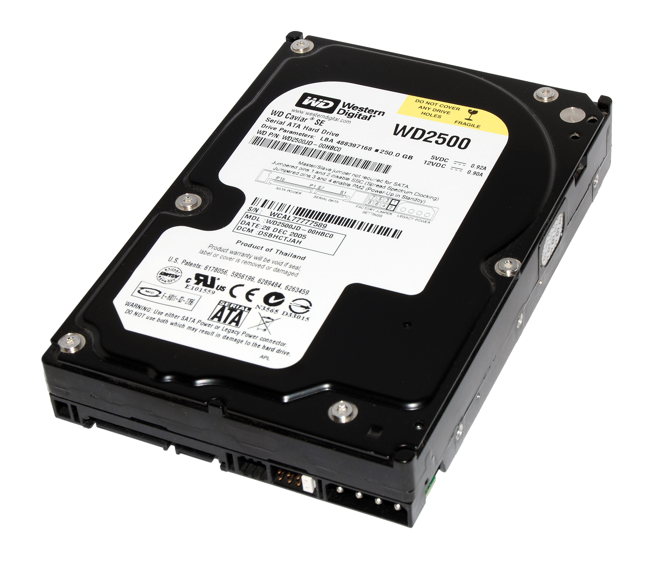
Challenges
Storage
No single hard disk/memory unit can store the data
Need to parallelize harddisks
All the problems of concurrent programming!
How to access the data?
What if a disk fails?
How fast is the access (read, write, delete)?
Physical limits: Energy cooling

Slide 15
Helpful Techniques: Lossless Compression
Entropy compression reduces data volume by removing redundant information (so fewer bits are used to store or transmit it!)
This compression is reversible but has mathematically proven limits.
Example:
AAAAAABBBBBCCC -> 6A5B3C

Slide 16
Helpful Techniques: Lossy Compression
Lossy compression reduces data volume by removing irrelevant information (and often can yield smaller files than lossless)
This compression is not fully reversible but only has perceptual limits.
There are trade-offs in using lossy and lossless compression techniques for storing and transmitting data.
Compression needs an agreement on decompression = “format”

Slide 17
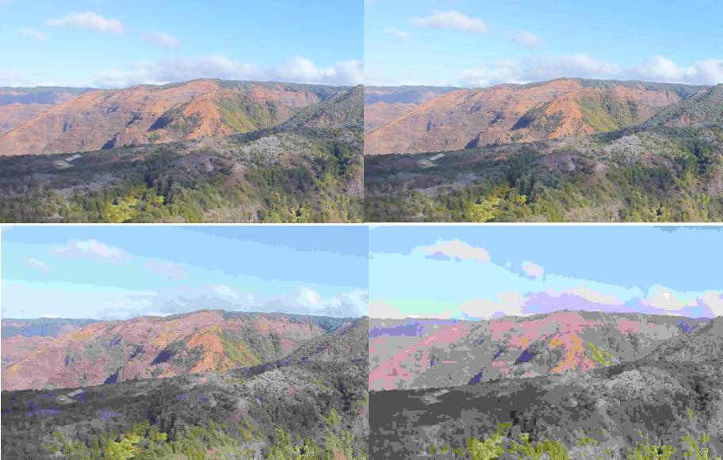
Lossy Compression Example: JPEG

Slide 18
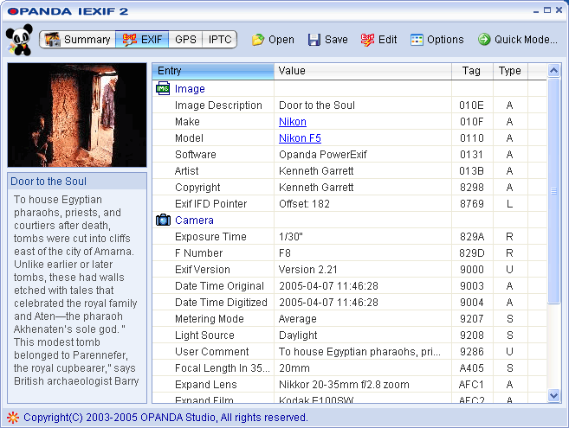
Techniques that help: Metadata
Metadata: Data about data
can be descriptive data about an image, a Web page, or other complex objects.
can increase the effective use of data or data sets by providing additional information about various aspects of that data.
(e.g., search)

Slide 19
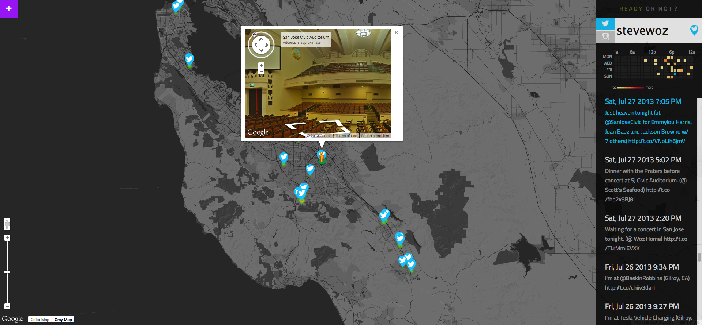
Main Reason for Digital Data
Digital data can be copied without loss, and sent instantly, permanently to everyone.
Data is stored in many formats depending on its characteristics (e.g., size and intended use).
The choice of storage media affects both the methods and costs of manipulating the data it contains.
Reading data and updating data have different storage requirements.
Problems with data that contains personal information:
Privacy
Security
Trade-offs in storing, transmitting

Slide 20
Main Reasons for Big Digital Data
Analyzing data at Internet-scale helps understand the world on never-before-seen scale.
Useful for empirical sciences:
What are the economic trends based on Google searches?
Are there animals that dance to music without human training?
How is the flu progressing?
`www.google.org/flutrends/us/
☑

Slide 21
Data: Conclusions and Visualization

Slide 22
Is Data the Solution to Everything?
“Even” Internet data is biased
It’s easy to draw conclusions too quickly
Sometimes finding the questions to ask is the hard part…
E.g., NetFlix Prize
“Predict whether someone will enjoy a movie based on how much they liked or disliked other movies”
Dataset: users and movie ratings
What questions can we ask of this data set?

Slide 23
Correlation does not Imply Causality!
en.wikipedia.org/wiki/Correlation_does_not_imply_causation!
cum hoc ergo propter hoc logical fallacy:
A occurs in correlation with B.
Therefore, A causes B.
Just because A and B are correlated does not necessarily imply one causes the other! It could be that…
A may be the cause of B
B may be the cause of A
some unknown third factor C may actually be the cause of A and B.
A caused B AND B caused A. This is a self-reinforcing system.
E.g., “preditor-prey” relationships
the "relationship" is a coincidence or so complex or indirect that it is more effectively called a coincidence (i.e. two events occurring at the same time that have no direct relationship to each other besides the fact that they are occurring at the same time).

Slide 24
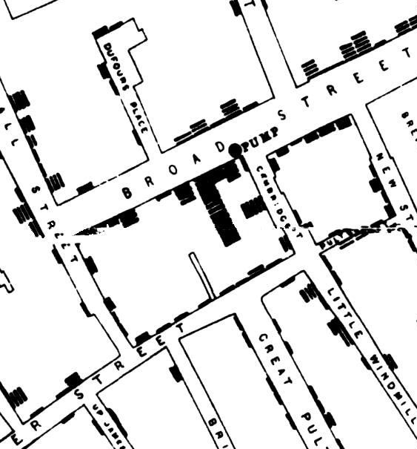
Benefits of Visualizations
en.wikipedia.org/wiki/1854_Broad_Street_cholera_outbreak
Visualization tools and software can communicate information about data
To communicate effectively the insights and knowledge gained from digitally represented information
Summarize the data analyzed computationally
Transform the information
Tables, diagrams, and textual displays
Interactivity with data is an aspect of communicating
John Snow’s visualization of the outbreak of Cholera in 1854 London

Slide 25
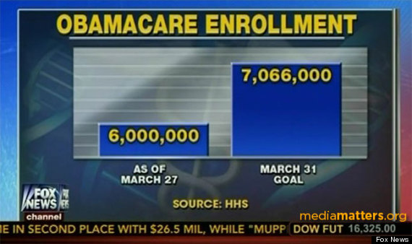
Visualization … Epic FAIL (2014)
www.huffingtonpost.com/2014/03/31/fox-news-obamacare-graphic_n_5063582.html

Slide 26

Visualization … Epic WIN (1869)
www.edwardtufte.com/tufte/posters
Charles Joseph Minard, Napoleon’s 1812 Russian Campaign

Slide 27
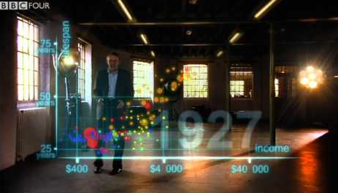
Visualization … Epic WIN (2009)
youtu.be/jbkSRLYSojo
Additional Videos:
Short Visualizations:
https://www.youtube.com/watch?v=QpdyCJi3Ib4
Full TED Talk:
http://www.ted.com/talks/hans_rosling_shows_the_best_stats_you_ve_ever_seen
Hans Rosling’s 200 countries, 200 years, 4 minutes – the joy of stats

Slide 28
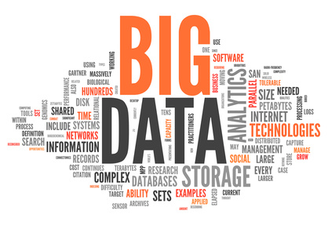
Summary
The right questions need to be answered by the proper data.
The rewards are high but handling data is an ongoing challenge to computer scientists as well as security specialists and privacy preservers.

